Slide 1
CM2601 – Object Oriented Development Week 3 Programming

Slide 2
Outline
Static methods and variables
Differences: instance, class and local variable
Using Java Predefined Classes
String class and Packages
Math class and Packages
Introduction to Inheritance

Slide 3
Last week…
Objects and Classes
Class declaration
Constructors
Object construction

Slide 4
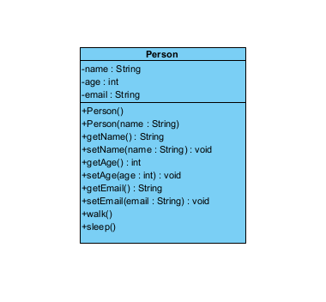
Quick Revision
A class is unit of encapsulation. It is a template used to create objects
An object is an instance of a class.
Notes:
Object − Objects have states and behaviors. Example: A dog has states - color, name, breed as well as behaviors – wagging the tail, barking, eating. An object is an instance of a class.
Class − A class can be defined as a template/blueprint that describes the behavior/state that the object of its type support.

Slide 5
Static methods
A method may be declared with the static keyword
Static methods live at class level, not at object level
Static methods may access static variables and
methods, but not dynamic ones
Example:
public static int getNumSold(){
return numTicketsSold;
}

Slide 6
Static Methods
A static method that is public can be accessed
ClassName.methodName(args)
Examples:
double result = Math.sqrt(25.0);
int numSold = Ticket.getNumberSold();
Notes:
https://docs.oracle.com/javase/7/docs/api/java/lang/Math.html

Slide 7
When to use static
A variable should be static if:
It logically describes the class as a whole
There should be only one copy of it
A method should be static if:
It does not use or affect the objects

Slide 8
Static – Non-static
We can access static variables without creating an instance of the class
As they are already available at class loading time, we can use them in any of our non static methods.
We cannot use non static methods and variables without creating an instance of the class as they are bound to the instance of the class.
They are initialized by the constructor when we create the object using new operator.

Slide 9
Recap: Class variables and methods
Instance variables belong to a specific instance.
Instance methods are invoked by an instance of the class.
Class variables are shared by all the instances of the class.
Class methods are not tied to a specific object.
To declare class variables and methods, use the static modifier.

Slide 10
Predefined Classes in Java
The String Class
Oracle doc
W3schools
Math Class
Oracle doc
W3schools

Slide 11
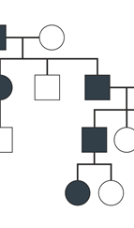
Inheritance
Inheritance allows a new class to be defined by extending or modifying an existing class.
The new class is referred to as a derived class or sub class.
The term base class or super class refers to the class that is extended.
The derived class inherits any public or protected members
both member variables and member methods.
Derived classes do not have access to any private members of the base class.
Inheritance is a key concept in OOP.

Slide 12
A Simple Class Hierarchy
In this section we will explore inheritance by investigating the following class hierarchy:
Person
Teacher
Student
PostGraduate

Slide 13
‘is a’
A Student is a Person
A PostGraduate is a Student and is a Person
A Teacher is a Person

Slide 14
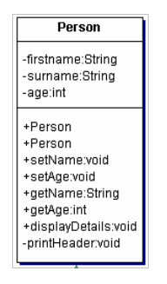
Person a Base Class
Start with a Person
This will be the base class of the hierarchy
provides useful common features

Slide 15
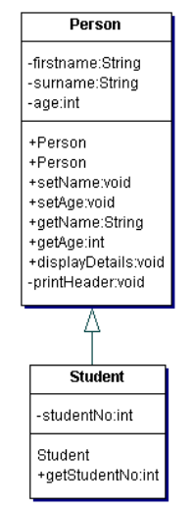
Student – Derived Class
Student extends Person by adding:
one member variable studentNo
one member function getStudentNo()
A Student is constructed by specifying a name, age and student number:
Student Alex = new Student( "Alex", "Smith", 20, 199913);

Slide 16
extends
In Java the keyword extends is used to indicate that one class is derived from another.
Only single inheritance is allowed in Java
That is the derived class can only extend one base class
Other languages allow multiple inheritance (C++, Python, Perl) where a derived class inherits from two or more base classes

Slide 17
‘super’ and Constructor chaining
Student extends Person
Student is derived from Person.
A student is a person plus a little bit more.
Note the use of super in the Student constructor during the lecture
super refers to the immediate base class.
Invokes the super class constructor with the appropriate signature.
A suitable constructor must exist in the base class otherwise the compilation will fail.
The derived class can have as many constructors as required but each must call a suitable base class constructor using super.

Slide 18
Overriding Base Class Methods
It may be better to output the student number as well as the other details in response to displayDetails.
A member method of a derived class can have the same name and signature as a base class member method.
The derived class method overrides the base class method.
The base class method can still be accessed from the derived class using super.BaseClassMethod()
For example: super.displayDetails()

Slide 19
Conclusion
Static methods and variables
Differences: instance, class and local variable
Introduction to Inheritance
Super keyword
Constructor chaining
Method overriding

Slide 20
Next
Further discussion on Inheritance and Abstraction in Java

